Slide 1
Analysis of Distribution of Network Characetristics of Genes Displays Phosphorylation and Acetylation Crosstalk

Slide 2
Overview:
This short set of slides analyzes the distribution of network characteristics (closeness, degree, betweenness and pagerank) of genes producing proteins that displays phosphorylation and acetylation crosstalk in cancer.
The data are acquired from cancer study and CAROM results [1][2].

Slide 3
Methods
Cancer crosstalk data from paper: Pan-cancer analysis of post-translational modifications reveals shared patterns of protein regulation SI table S6I.
Network characteristic data from paper: Metabolic signatures of regulation by phosphorylation and acetylation SI table S1S.
Mapping database from Uniprot website: https://www.uniprot.org/id-mapping
Separate negatively and positively correlated proteins.
Map to corresponding genes and filter through desired threshold.
Make boxplots for positively, negatively related genes and overall population distribution w.r.t betweenness, closeness, degree and pagerank.

Slide 4
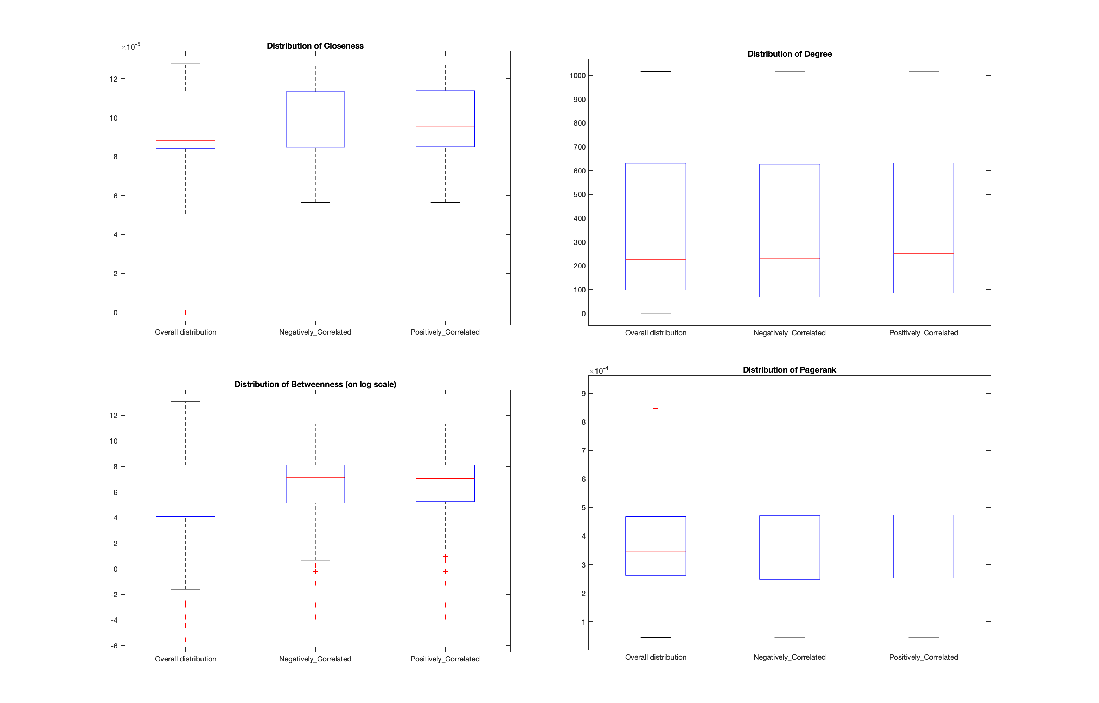
Results: Threshold: correlation>0

Slide 5
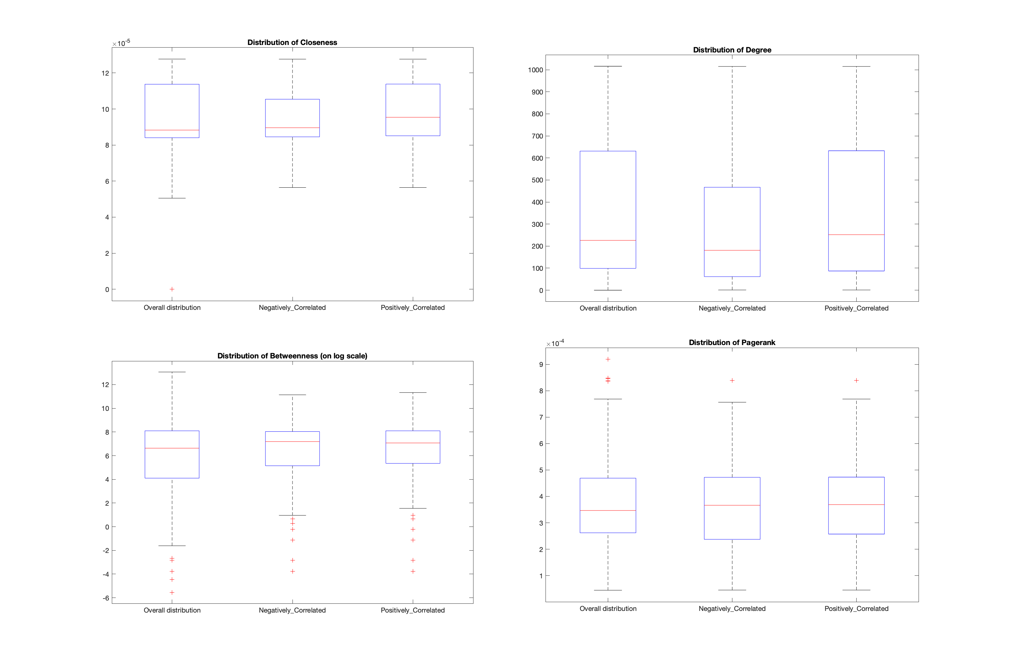
Results: Threshold: correlation>0.2

Slide 6
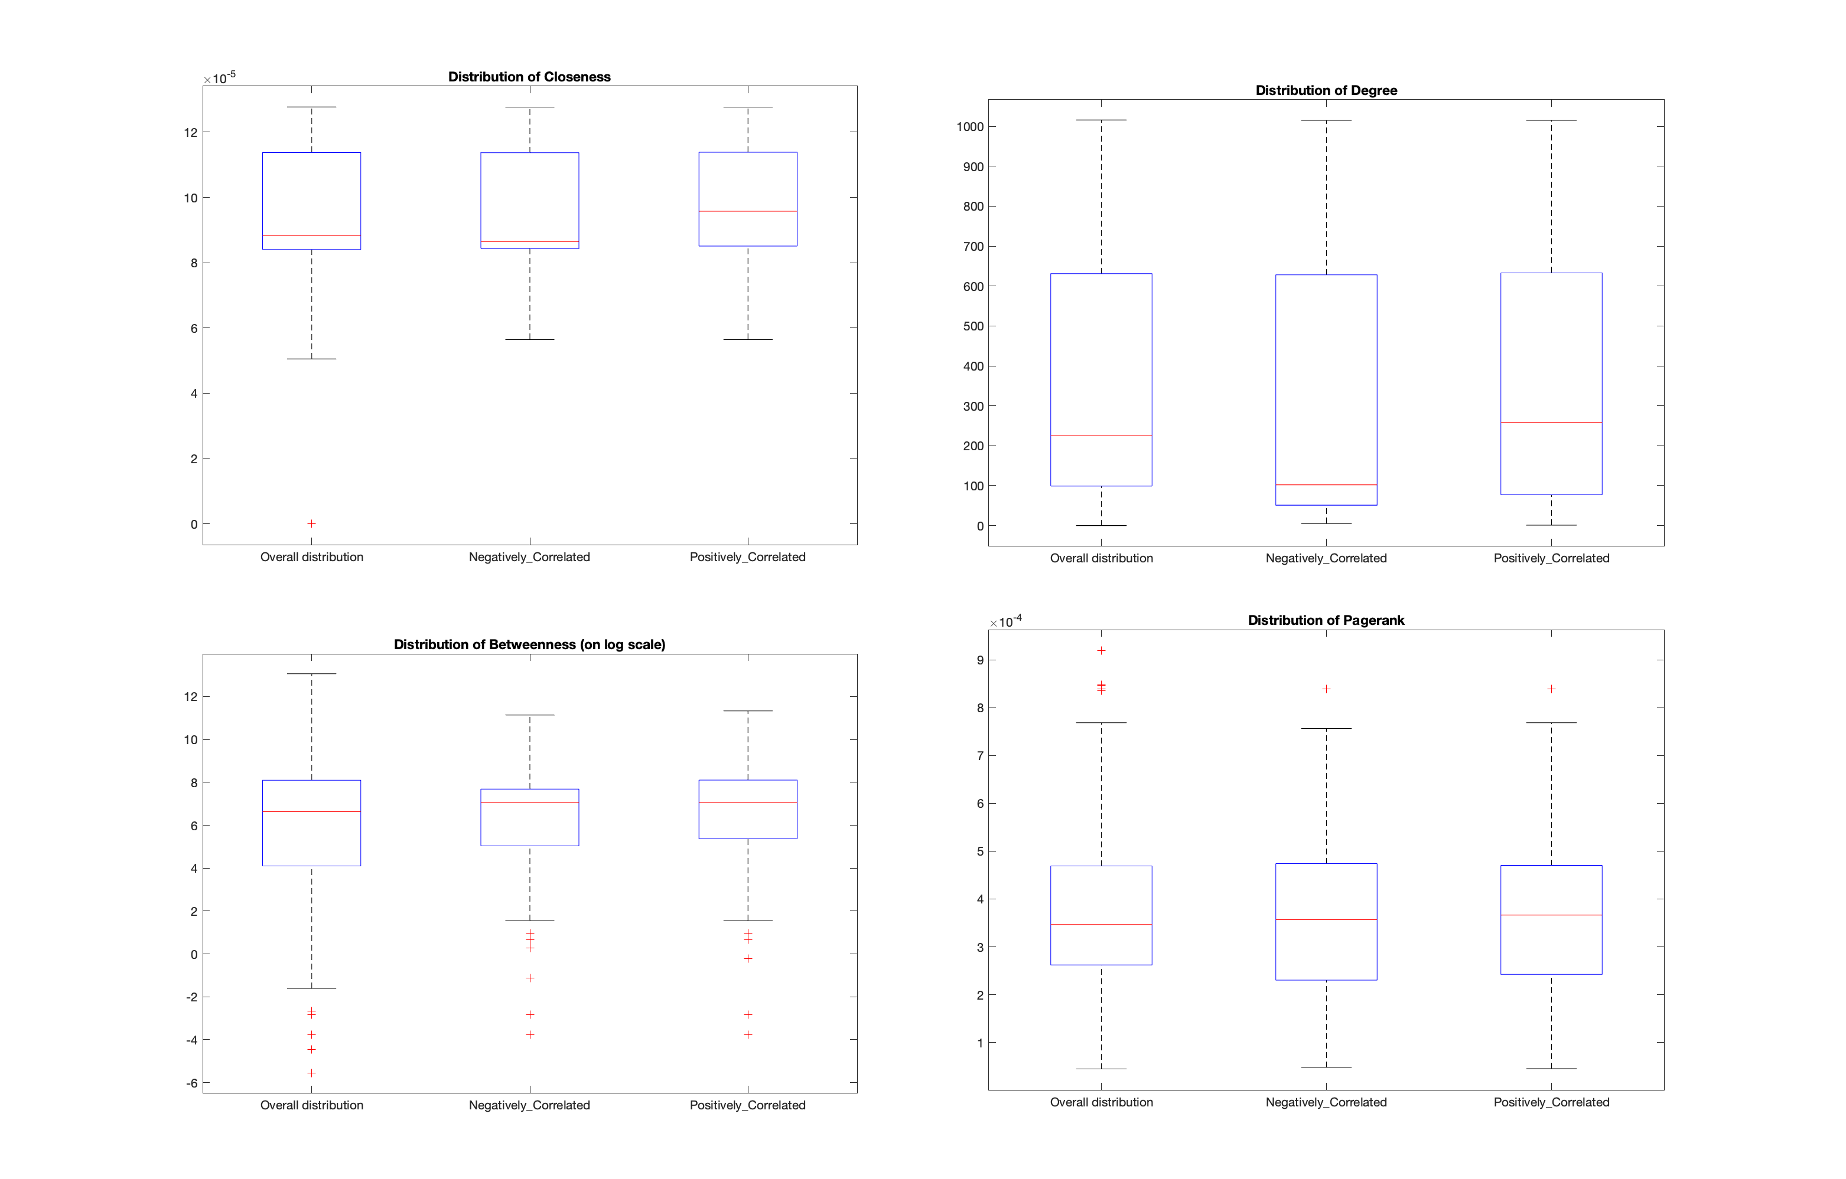
Results: Threshold: correlation>0.5

Slide 7
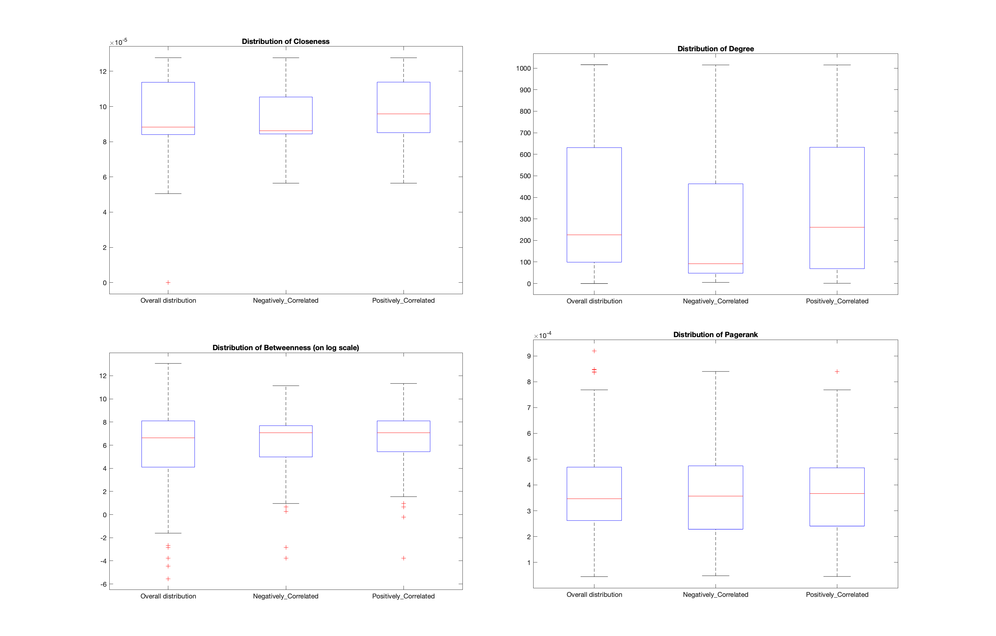
Results: Threshold: correlation>0.7

